Slide 1
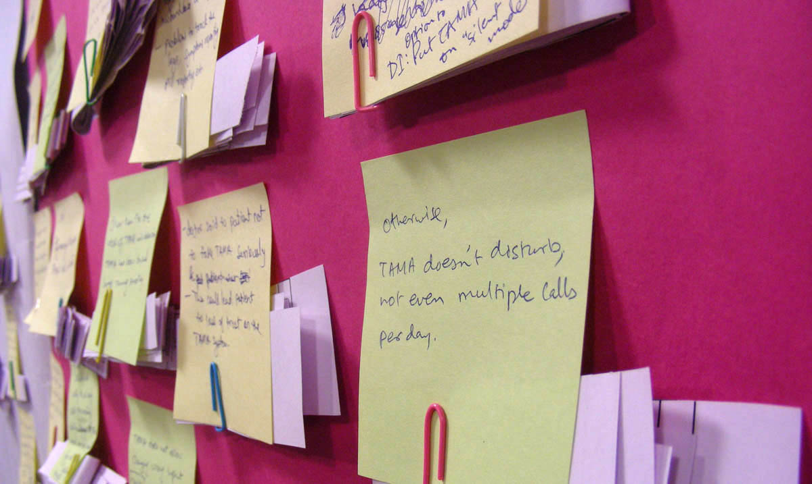
Workshop for PhD Aspirants
February 23-24, 2013

Slide 2
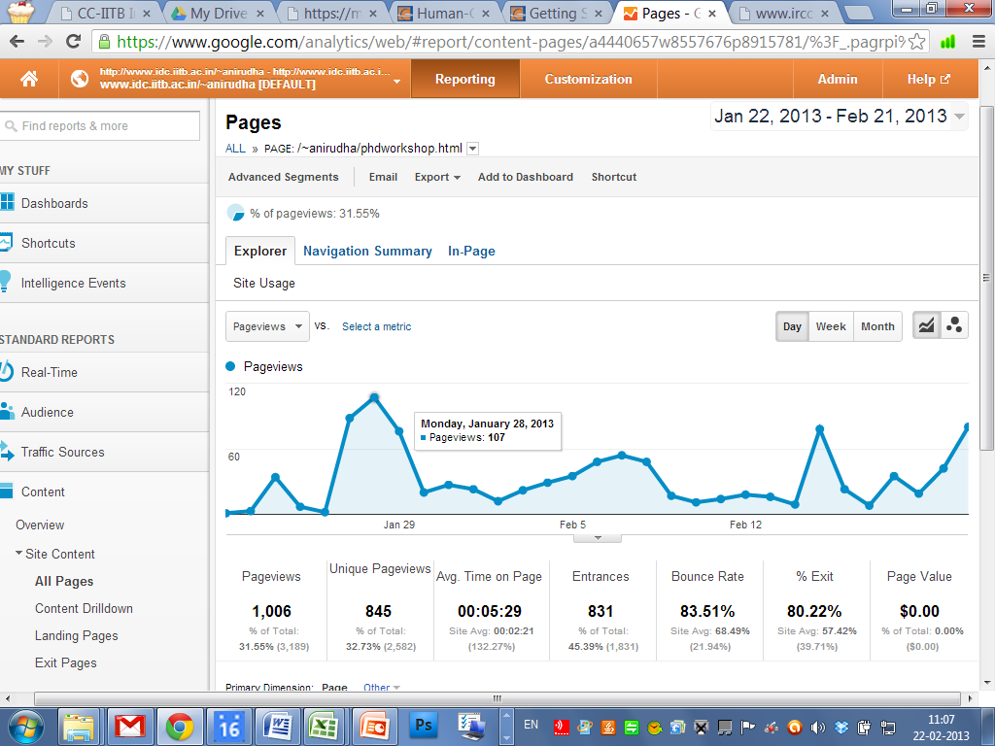

Slide 3
Response
http://www.idc.iitb.ac.in/~anirudha/phdworkshop.html
1,185 page views (as of 25-2-2013) of which 982 were unique page views
73 people expressed interest by email
59 people actually submitted SoPs
52 people attended the workshop
24 people have signed up for the googlegroup (so far)

Slide 4
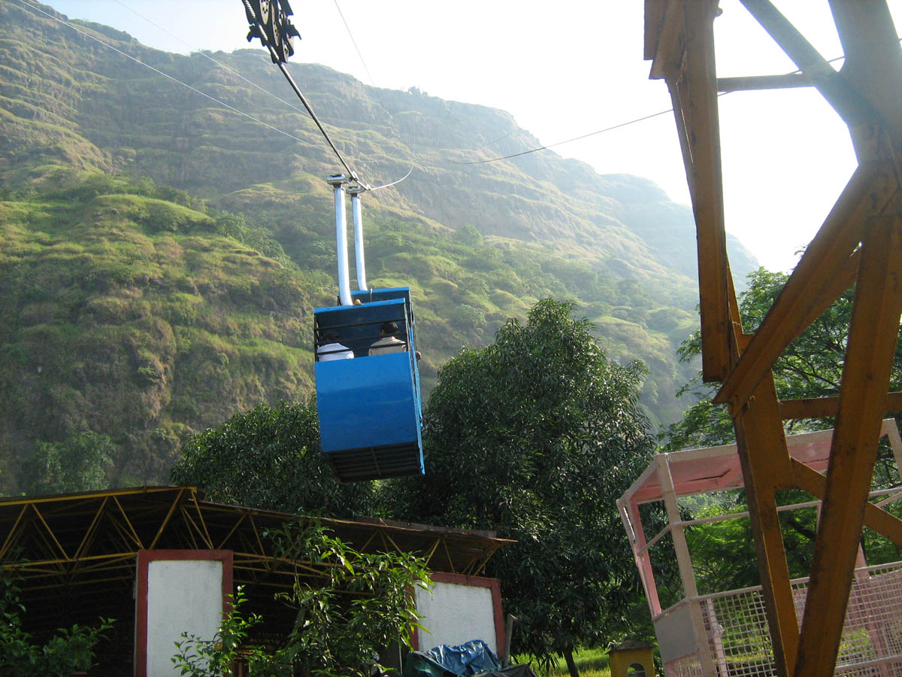

Slide 5
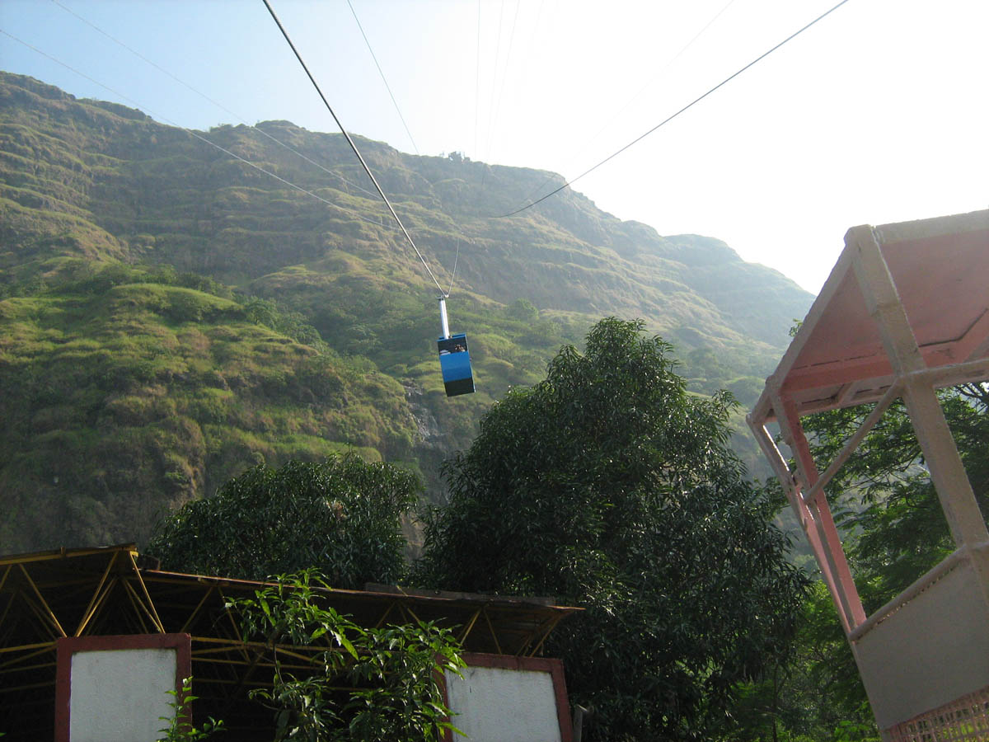

Slide 6
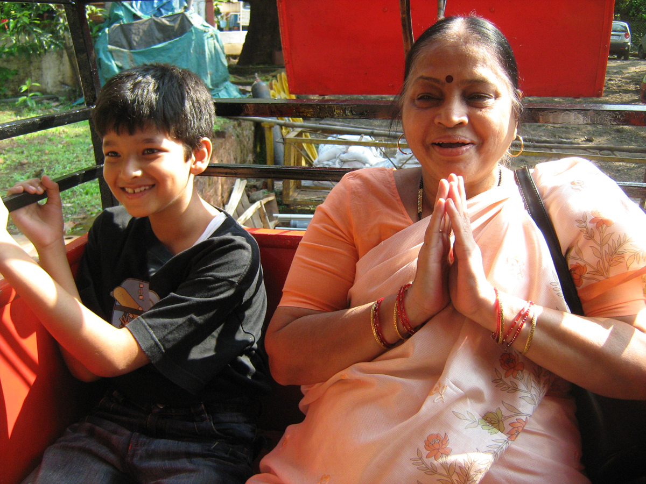

Slide 7


Slide 8
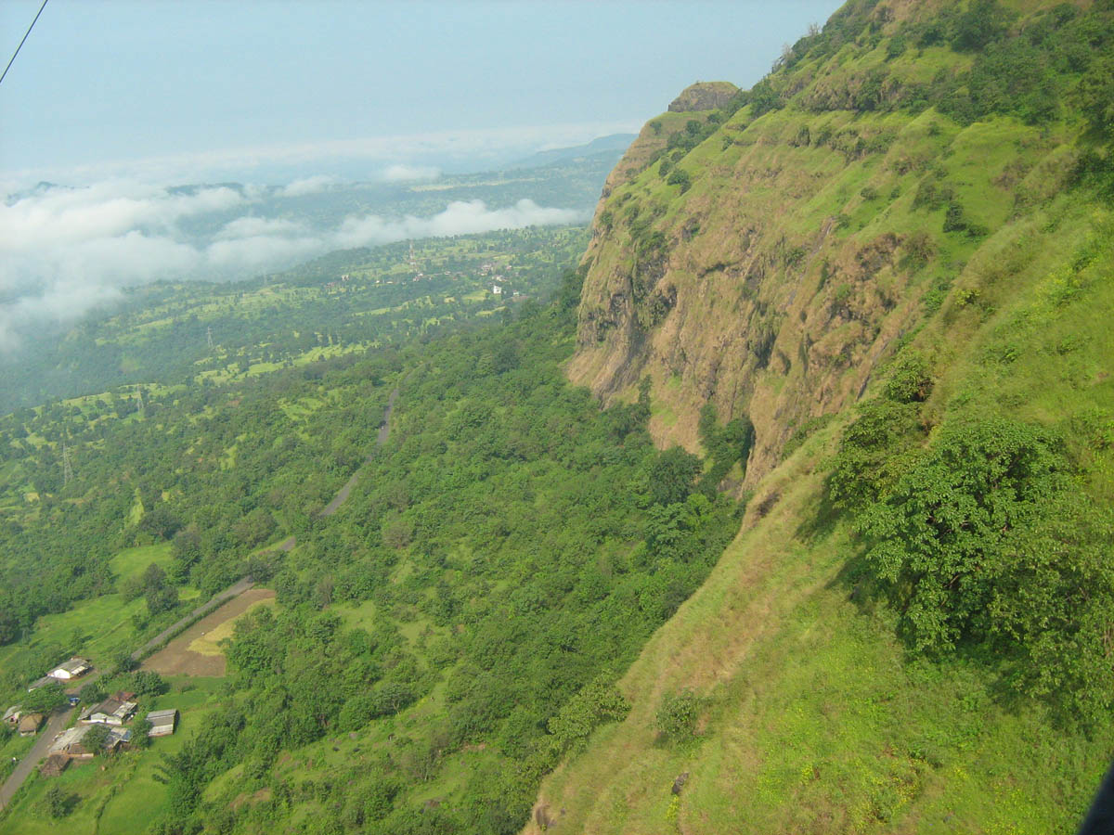

Slide 9
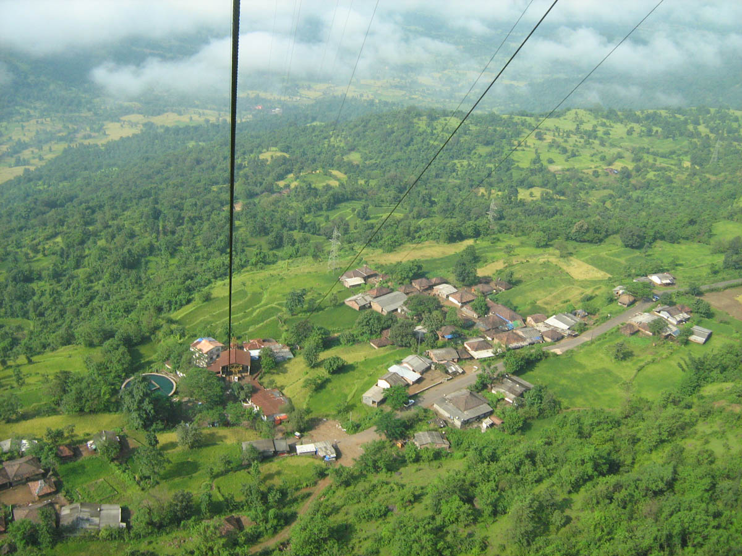

Slide 10
Keynote: Prof. Uday Athavankar

Slide 11
Tea break

Slide 12
11:00 am to 12:15 pm Panel discussion
What is a PhD in design?
How is it different from design?
Chair: Prof. UA Athavankar
Prof. Anirudha Joshi
Porf. Nina Sabnani
Neelakantan K
Shikha Agarwal
Aakash Jhori

Slide 13
12:15 pm to 12:45 pm
Alumnus talk
Dr. Girish Dalvi

Slide 14
Lunch

Slide 15
2:00 pm to 3:00 pm
How to prepare a PhD proposal?
Prof. Nina Sabnani
Neelakantan K
Saurabh Singanapalli

Slide 16
3:15 pm to 5:30 pm
Introduction to research areas in IDC
Prof. Anirudha Joshi
Prof. GV Sreekumar
Prof. Nina Sabnani
Prof. Vijay Bapat
Prof. Nishant Sharma
Prof. Pramod Khambete
Prof. Ravi Poovaiah
Prof. GG Ray

Slide 17
Keynote: Prof. Uday Khedkar

Slide 18
Tea break

Slide 19
11:00 am to 12:15 pm
Life as a PhD Student
Chair: Sharmila Sinha
Susmita Sharma
Prof. Santosh Kshirsagar
Abhishek Srivastava
Shikha Agarwal
Ravi Shankar
Prof. Anirudha Joshi
Prof. GG Ray
Anisha Malhotra
Neelkantan K

Slide 20
12:15 pm to 12:45 pm
Alumnus talk
Dr. Rajendra Patsute

Slide 21
Lunch

Slide 22
2:00 pm to 4:45 pm
Breakout sessions

Slide 23
4:45 pm to 5:00 pm
Vote of thanks

